Slide 1
Phishing website prediction using base and ensemble classifier techniques with cross-validation

Slide 2
ABSTRACT
This research addresses the escalating threat of phishing in the realm of public internetworks, aiming to enhance the security of internet users. Despite ongoing efforts to fortify IT infrastructure, the paper emphasizes the persistent risk of phishing attacks and focuses on the detection and prediction of phishing website URLs. Employing machine learning, the study employs primary classifiers such as Logistic Regression, Decision Tree, SVM, KNN, Naive Bayes, LDA, and ensemble-based techniques including CNN, RNN, and a Voting Classifier. The investigation unfolds in three phases: initial classification with base classifiers, subsequent deployment of ensemble classifiers, and evaluation with and without cross-validation on distinct datasets. Notably, CNN and RNN achieve remarkable 100% accuracy. The findings underscore the significance of ensemble techniques in phishing website prediction, providing valuable insights for future research and contributing to the ongoing efforts to secure online environments.

Slide 3
INTRODUCTION
In an era where our reliance on the internet is pervasive, encompassing everything from online shopping and banking to sophisticated intelligent home solutions, our daily lives and work culture have undergone a significant transformation. However, this increased connectivity has brought about a proportional rise in the number of threats that jeopardize our digital existence. The globally operated network platforms, while offering unprecedented convenience, are also fertile grounds for various forms of cyber threats.
Beyond the well-known menaces like hacking, cracking, and the activities of online terrorist organizations, one particularly insidious threat looms large – phishing. This online criminal activity often goes unnoticed or is insufficiently acknowledged by its victims. Phishing poses a significant risk to users, with attackers targeting two primary groups: the uninformed newbies who lack awareness of the technical intricacies of the internet, and the careless individuals who, despite understanding the associated risks, remain inattentive to online security.
This paper delves into the escalating concern of phishing attacks, exploring the challenges posed by this form of cybercrime. As users increasingly navigate the digital landscape, it becomes imperative to comprehensively address the multifaceted nature of phishing threats and devise robust strategies to safeguard against them.

Slide 4
OBJECTIVE
This study aims to enhance phishing website detection on public internetworks by employing machine learning classifiers, including CNN, RNN, Logistic Regression, Decision Tree, SVM, KNN, Naive Bayes, LDA, and a Voting Classifier. The research evaluates their performance, emphasizing the importance of ensemble techniques in bolstering internet security.

Slide 5
PROBLEM STATEMENT
The pervasive threat of phishing in public internetworks poses a persistent risk to users' data security. Despite continuous efforts, the challenge lies in effectively detecting and predicting phishing websites. This study addresses this concern, employing diverse machine learning classifiers to enhance the identification and mitigation of phishing threats.

Slide 6
LITERATURE SURVEY
Phishing URL Detection with Lexical Features and Blacklisted Domains:
Phishing URL Detection with Lexical Features and Blacklisted Domains | SpringerLink
ABSTRACT: Many cyberattacks start with phishing to lure victims into malicious web pages where malware codes are hidden. Victim machines are infected by malware and the attacker can intrude the enterprise network, evading firewalls. Therefore, it is of fundamental importance to detect phishing URLs and prevent employees from visiting them. Many machine learning methods were proposed so far. In this work, we collect many lexical features after literature survey and combine them with blacklisted domains to improve the detection performance. We collect many recent phishing URLs because most of open datasets are outdated. Our method shows the F-1 of 0.84.

Slide 7
LITERATURE SURVEY
A predictive model for phishing detection:
A predictive model for phishing detection - ScienceDirect
ABSTRACT: Nowadays, many anti-phishing systems are being developed to identify phishing contents in online communication systems. Despite the availability of myriads anti-phishing systems, phishing continues unabated due to inadequate detection of a zero-day attack, superfluous computational overhead and high false rates. Although Machine Learning approaches have achieved promising accuracy rate, the choice and the performance of the feature vector limit their effective detection. In this work, an enhanced machine learning-based predictive model is proposed to improve the efficiency of anti-phishing schemes. The predictive model consists of Feature Selection Module which is used for the construction of an effective feature vector. These features are extracted from the URL, webpage properties and webpage behaviour using the incremental component-based system to present the resultant feature vector to the predictive model. The proposed system uses Support Vector Machine and Naïve Bayes which have been trained on a 15-dimensional feature set. The experiments were based on datasets consisting of 2541 phishing instances and 2500 benign instances. Using 10-fold cross-validation, the experimental results indicate a remarkable performance with 0.04% False Positive and 99.96% accuracy for both SVM and NB predictive models.

Slide 8
LITERATURE SURVEY
PhiDMA – A phishing detection model with multi-filter approach:
PhiDMA – A phishing detection model with multi-filter approach - ScienceDirect
ABSTRACT: Phishing remains a basic security issue in the cyberspace. In phishing, assailants steal sensitive information from victims by providing a fake site which looks like the visual clone of a legitimate site. Phishing shall be handled using various approaches. It is established that single filter methods would be insufficient to detect different categories of phishing attempts. This paper provides a multilayer model to detect phishing, titled as PhiDMA(Phishing Detection using Multi-filter Approach). The PhiDMA model incorporates five layers: Auto upgrade whitelist layer, URL features layer, Lexical signature layer, String matching layer and Accessibility Score comparison layer. A prototype implementation of the proposed PhiDMA model is built with an accessible interface so that persons with visual impairments shall access it without any barrier. The result from the experiment shows that the model is capable to detect phishing sites with an accuracy of 92.72%.

Slide 9
LITERATURE SURVEY
CBR-PDS: a case-based reasoning phishing detection system:
CBR-PDS: a case-based reasoning phishing detection system | Request PDF (researchgate.net)
ABSTRACT: Phishing attacks have become the preferred vehicle to gather sensitive information as well as to deliver dangerous malware. So far, there is still no phishing detection system that can perfectly detect and progressively self adapt to differentiate between phishing and legitimate websites. This paper proposes the case-based reasoning Phishing detection system (CBR-PDS) that relies on previous cases to detect phishing attacks. CBR-PDS is highly adaptive and dynamic as it can adapt to detect new phishing attacks using rather a small dataset size in contrast to other machine learning techniques. CBR-PDS aims to improve the detection accuracy and the reliability of the results by identifying a set of discriminative features and discarding irrelevant features. CBR-PDS relies on a two stage hybrid procedure using Information gain and Genetic algorithms. The reduction of the data dimensionality amounts to an improved accuracy rate, yet it necessitates a reduced processing time.

Slide 10
LITERATURE SURVEY
Machine learning based phishing detection from URLs:
Machine learning based phishing detection from URLs - ScienceDirect
ABSTRACT: Due to the rapid growth of the Internet, users change their preference from traditional shopping to the electronic commerce. Instead of bank/shop robbery, nowadays, criminals try to find their victims in the cyberspace with some specific tricks. By using the anonymous structure of the Internet, attackers set out new techniques, such as phishing, to deceive victims with the use of false websites to collect their sensitive information such as account IDs, usernames, passwords, etc. Understanding whether a web page is legitimate or phishing is a very challenging problem, due to its semantics-based attack structure, which mainly exploits the computer users’ vulnerabilities. Although software companies launch new anti-phishing products, which use blacklists, heuristics, visual and machine learning-based approaches, these products cannot prevent all of the phishing attacks. In this paper, a real-time anti-phishing system, which uses seven different classification algorithms and natural language processing (NLP) based features, is proposed.

Slide 11
EXSISTING SYSTEM
The existing system employs a cutting-edge approach to combat the pervasive threat of phishing attacks by leveraging machine learning, specifically utilizing the Gradient Boosting Classifier model. The system focuses on scrutinizing various aspects of URL significance to distinguish between legitimate and phishing websites. By extracting and comparing distinctive features, such as linguistic and aesthetic elements, the Gradient Boosting Classifier is adept at identifying phishing URLs. This innovative method offers real-time detection capabilities, providing a robust defense against evolving phishing techniques facilitated by advancing technology. Recognizing the ease with which attackers exploit human susceptibility, the system serves as a proactive safeguard against unauthorized access to personal information. Through rigorous testing, the findings affirm the efficacy of the proposed approach, demonstrating its ability to successfully discern between authentic and malicious websites, thereby fortifying cybersecurity measures in the face of escalating phishing threats.

Slide 12
DISADVANATAGES FOR EXISTING SYSTEM
The existing system relies solely on the Gradient Boosting Classifier, potentially overlooking nuanced phishing patterns that other algorithms may better detect.
The system's emphasis on linguistic and aesthetic features may make it susceptible to evolving phishing techniques that exploit novel characteristics not considered in the current feature set.
Focusing primarily on URL features might result in reduced accuracy when dealing with phishing attempts that employ sophisticated tactics beyond URL manipulation.
The system may face challenges in adapting to the rapidly changing phishing landscape, as it might struggle to incorporate new features or adapt its model to emerging attack vectors.

Slide 13
PROPOSED SYSTEM
The proposed system introduces a robust cybersecurity solution employing an ensemble of machine learning algorithms, including CNN, RNN, Logistic Regression, Decision Tree, SVM, KNN, Naive Bayes, LDA, and a Voting Classifier. Notably, the system prioritizes the superior accuracy achieved by Convolutional Neural Networks (CNN) and Recurrent Neural Networks (RNN) in comparison to other algorithms. This emphasis on CNN and RNN, acknowledged for their proficiency in detecting phishing websites, aims to elevate the system's overall performance. By leveraging the strengths of these advanced algorithms, the proposed system seeks to enhance the accuracy and efficiency of phishing detection and prediction. This strategic amalgamation of diverse classifiers underscores the system's commitment to providing a comprehensive defense mechanism against the dynamic landscape of online threats, ensuring heightened security for users engaged in various internet activities.

Slide 14
ADVANATAGES FOR PROPOSED SYSTEM
The proposed system incorporates a wide array of machine learning algorithms, ensuring a more comprehensive and adaptive approach to phishing detection.
Prioritizing Convolutional Neural Networks (CNN) and Recurrent Neural Networks (RNN) acknowledges their proven efficacy, potentially enhancing the system's accuracy in detecting complex phishing patterns.
Leveraging multiple advanced algorithms aims to improve overall system performance, providing a more robust defense against a diverse range of phishing tactics.
The strategic amalgamation of diverse classifiers demonstrates the proposed system's commitment to offering a holistic cybersecurity solution, capable of addressing the dynamic nature of online threats.

Slide 15
REQUIREMENTS
SOFTWARE
HARDWARE
Software : Anaconda
Primary Language : Python
Frontend Framework : Flask
Back-end Framework : Jupyter Notebook
Database : Sqlite3
Front-End Technologies : HTML,CSS,JavaScript and Bootstrap4
1) Operating System : Windows Only
2) Processor : i5 and above
3) Ram : 8gb and above
4) Hard Disk : 25 GB in local drive

Slide 16
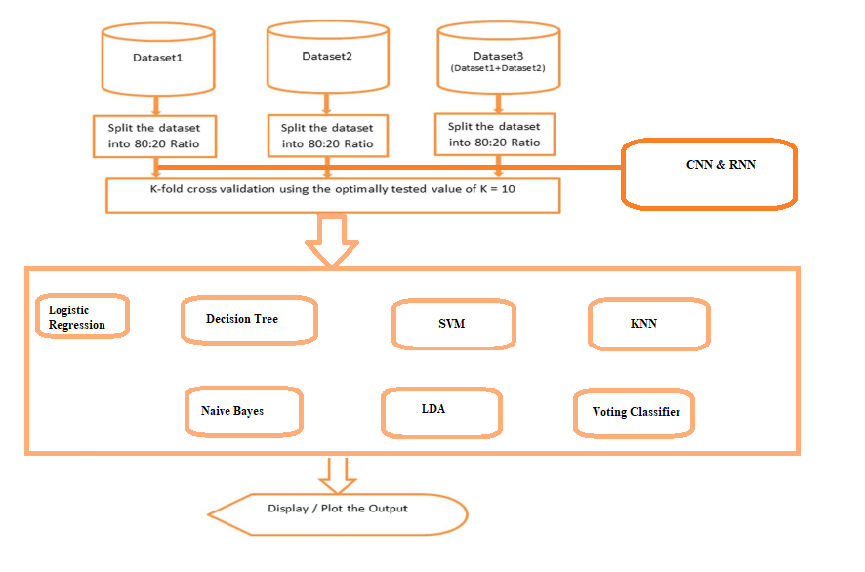
SYSTEM ARCHITECTURE

Slide 17
UML DIAGRAMS

Slide 18
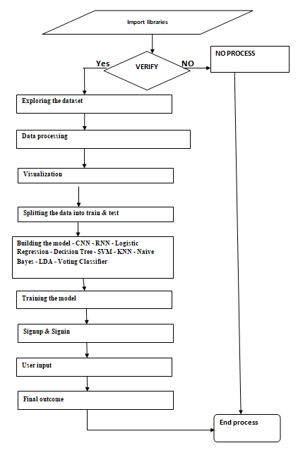
DATAFLOW DIAGRAM

Slide 19
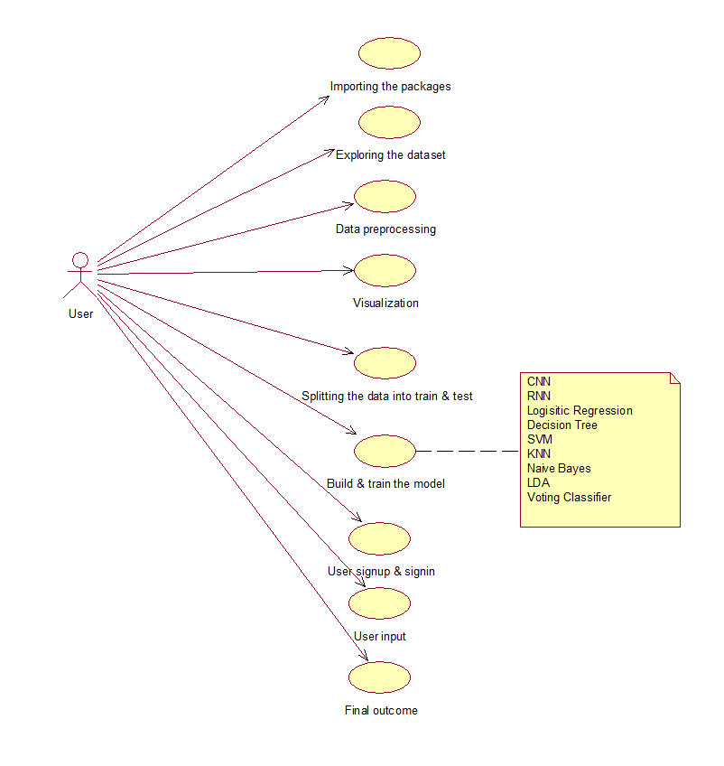
USECASE DIAGRAM

Slide 20
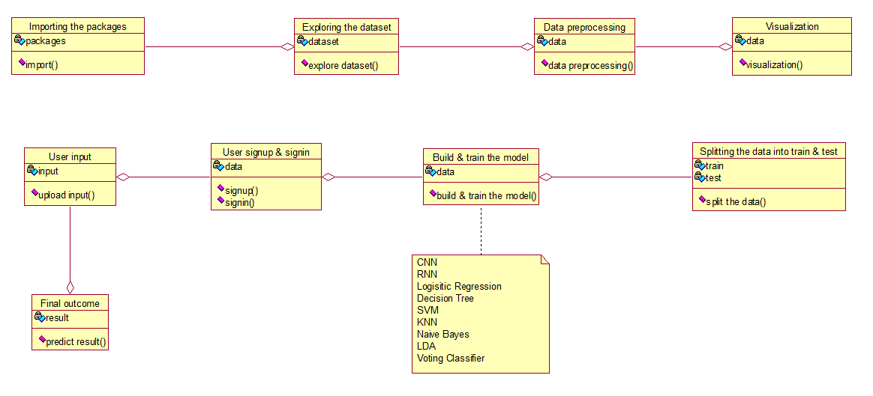
CLASS DIAGRAM

Slide 21
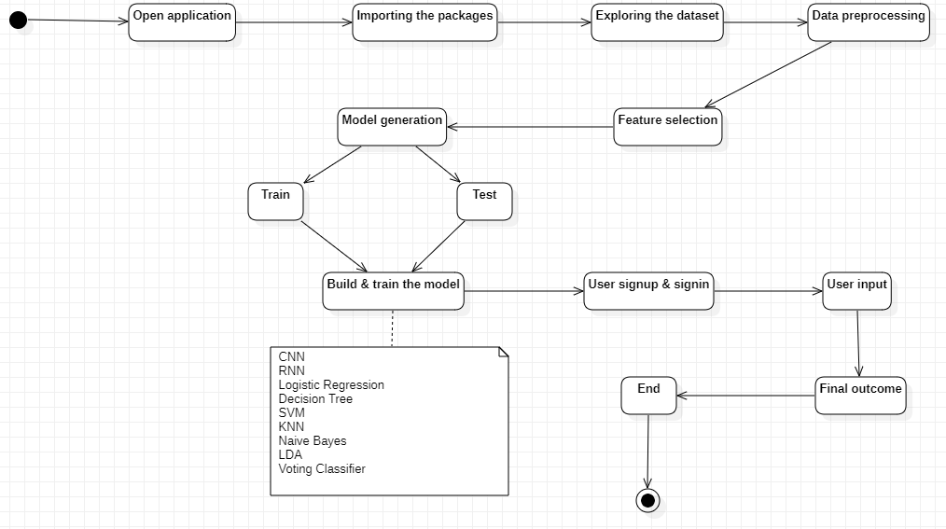
ACTIVITY DIAGRAM

Slide 22
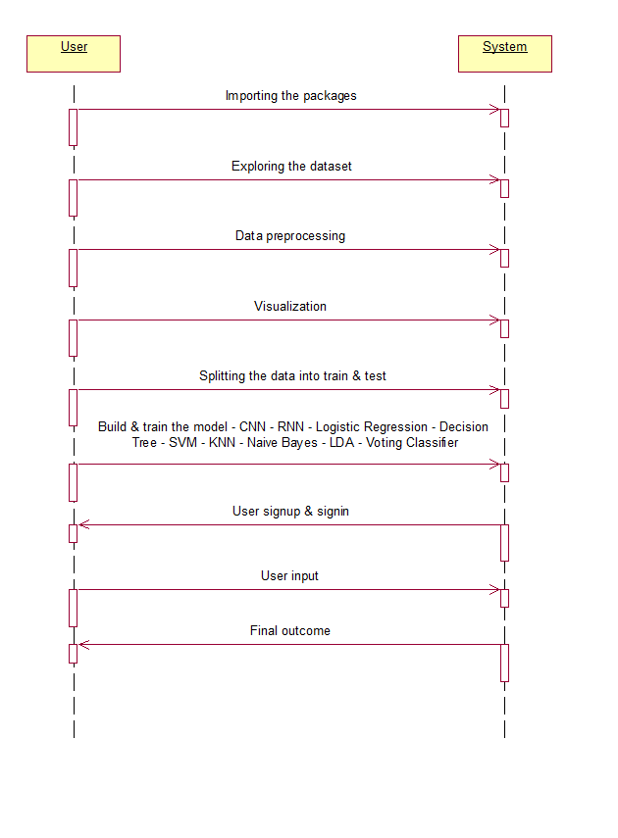
SEQUENCE DIAGRAM

Slide 23
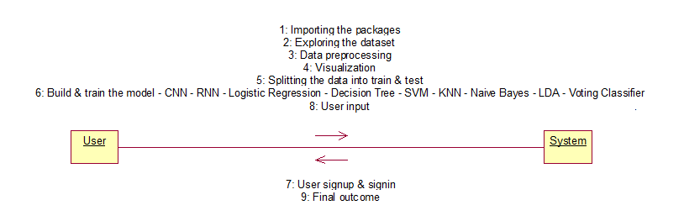
COLLABORATION DIAGRAM

Slide 24
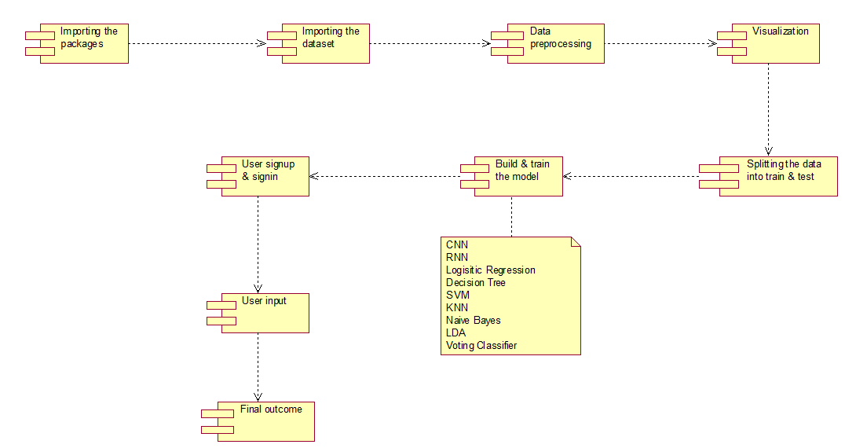
COMPONENT DIAGRAM

Slide 25
DEPLOYMENT DIAGRAM

Slide 26
SCREENSHOTS

Slide 27
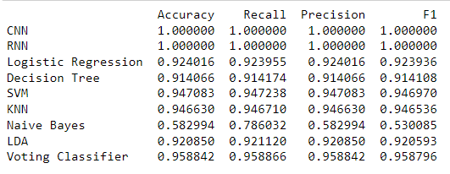
COMPARISION GRAPH AND PERFORMANCE EVALUATION TABLE FOR DATASET-1

Slide 28
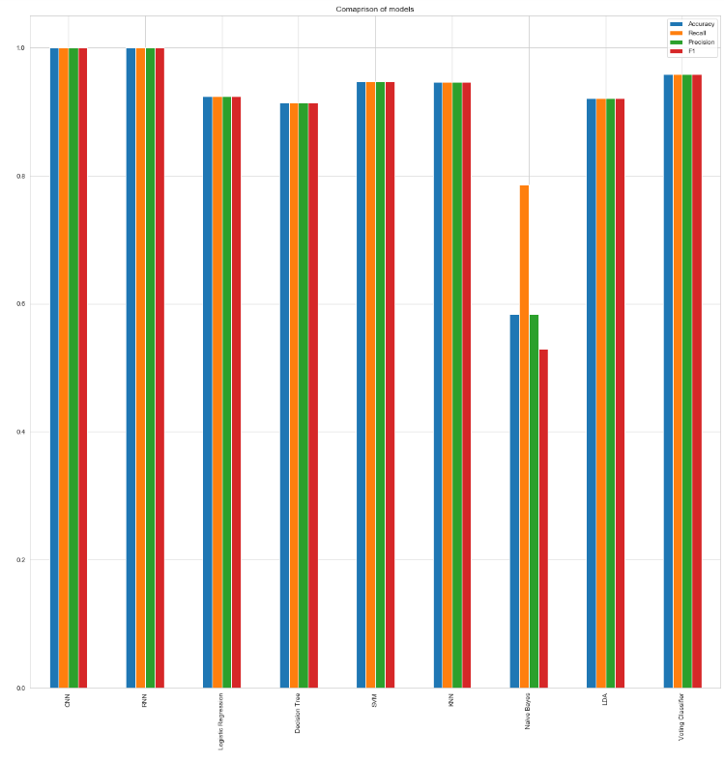

Slide 29
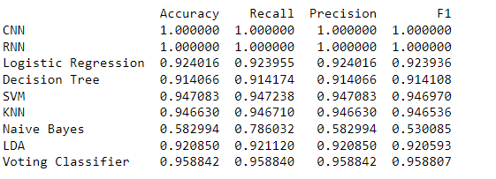
COMPARISION GRAPH AND PERFORMANCE EVALUATION TABLE FOR DATASET-2

Slide 30
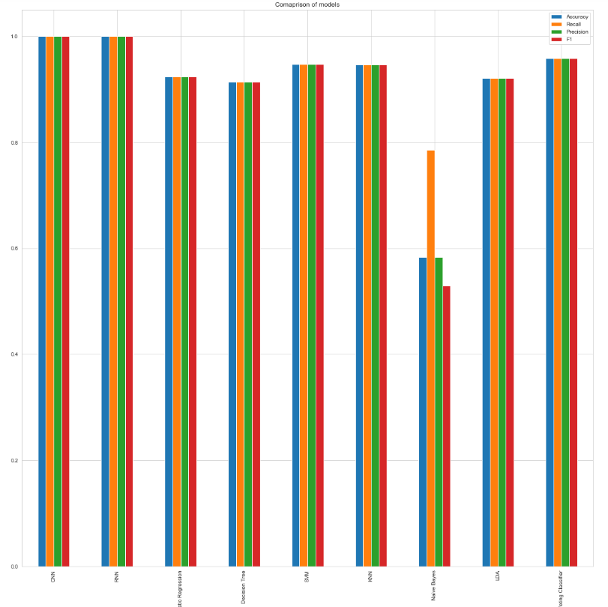

Slide 31
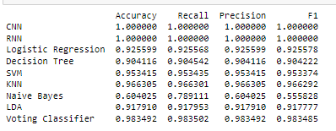
COMPARISION GRAPH AND PERFORMANCE EVALUATION TABLE FOR DATASET-3

Slide 32
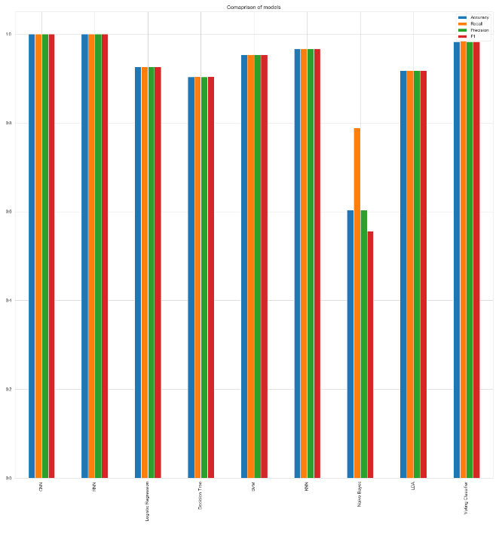

Slide 33

SCREENS

Slide 34


Slide 35


Slide 36


Slide 37
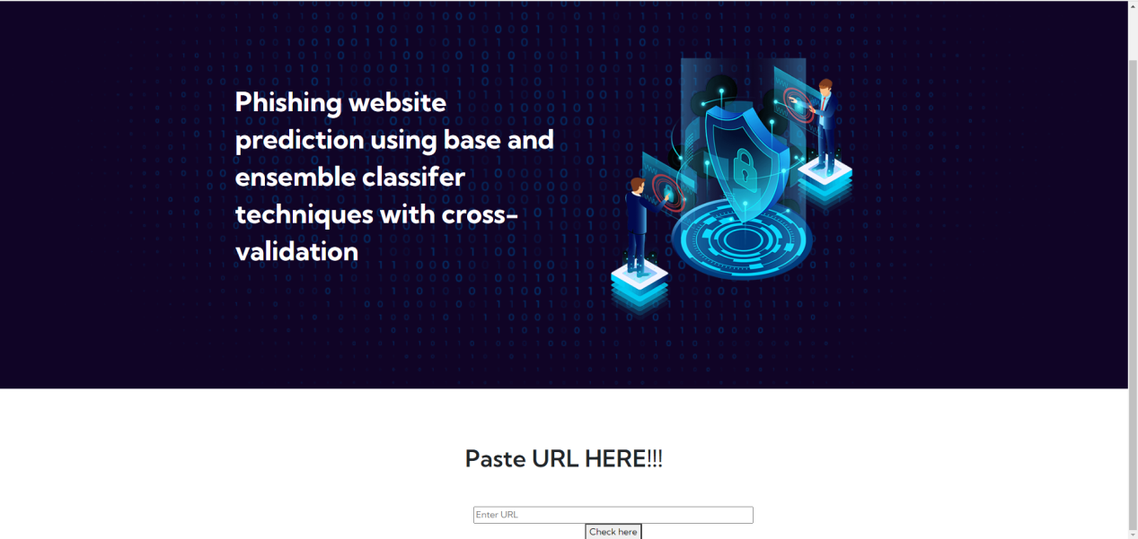

Slide 38
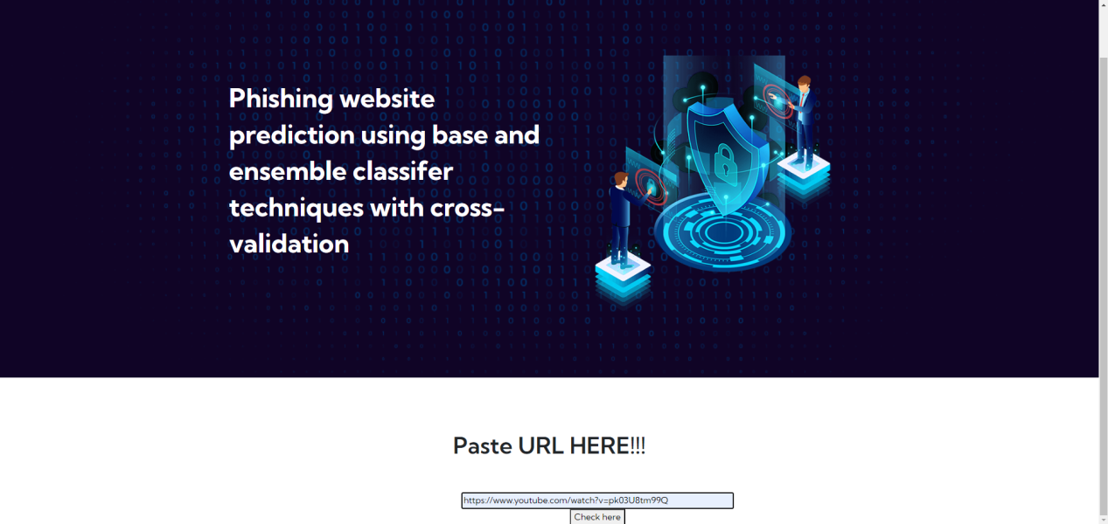

Slide 39


Slide 40
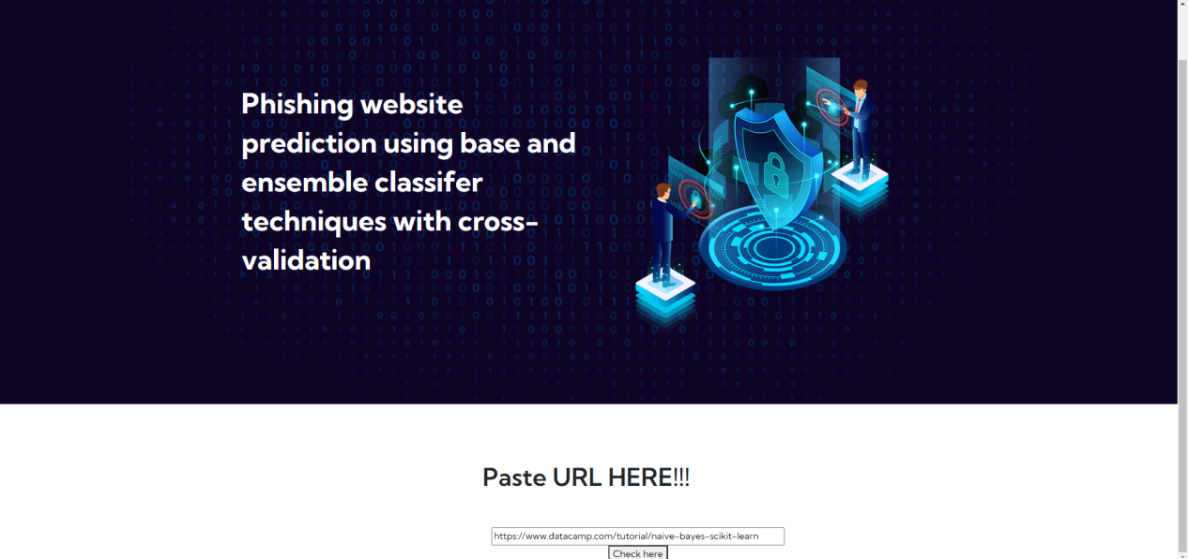

Slide 41


Slide 42
CONCLUSION
In conclusion, this study underscores the pressing need for robust cybersecurity measures in the face of escalating phishing threats within the expanding digital landscape. The comprehensive evaluation of diverse machine learning algorithms, including CNN, RNN, Logistic Regression, Decision Tree, SVM, KNN, Naive Bayes, LDA, and a Voting Classifier, reveals the pivotal role of Convolutional Neural Networks (CNN) and Recurrent Neural Networks (RNN) in achieving notably high accuracy levels. The proposed ensemble-based approach harnesses the collective strengths of these algorithms to fortify the system's capability in detecting and predicting phishing activities. The findings emphasize the significance of staying ahead of evolving cyber threats, with CNN and RNN emerging as powerful tools in mitigating the risks associated with phishing attacks. By combining advanced classifiers, the proposed system offers a multifaceted defense mechanism against the diverse tactics employed by cybercriminals. The incorporation of cross-validation further validates the reliability of the ensemble classifiers. This research not only contributes valuable insights to the field of cybersecurity but also advocates for the adoption of state-of-the-art techniques to ensure a more secure online environment for users across various internet domains.

Slide 43
REFERENCES
[1] 2020 Phishing Attack Landscape. https://info.greathorn.com/report-2020- phishing-attack-landscape. Accessed 13 Sept 2020
[2] Abdelhamid N, Abdel-jaber H (2017) Learning comparison based on models content and features, pp 72–77
[3] Abutair H et al (2019) CBR-PDS: a case-based reasoning phishing detection system. J Ambient Intell Humaniz Comput 10(7):2593–2606. https://doi. org/10.1007/s12652-018-0736-0
[4] Ali W (2017) Phishing website detection based on supervised machine learning with wrapper features selection. Int J Adv Comput Sci Appl 8(9):72–78
[5] Breiman L (2001) Random forests. Mach Learn 45(1):5–32. https://doi.org/10. 1023/A:1010933404324

